Slide 1

Data Representation and Analysis
Session 1: Introduction to Python and Data
Hasitha Pramuditha

Slide 2

Welcome to Session 1!
Understand what programming and data analysis mean.
Learn basic Python commands and concepts.
Set up and use Jupyter notebooks.
Start working with simple data.

Slide 3
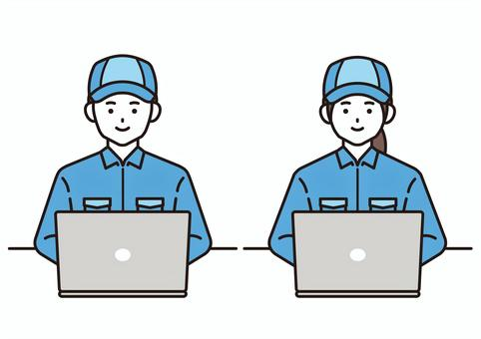
What is Programming?
Giving instructions to a computer.
Like writing a recipe for a computer to follow.
Computers are smart but need precise instructions!

Slide 4
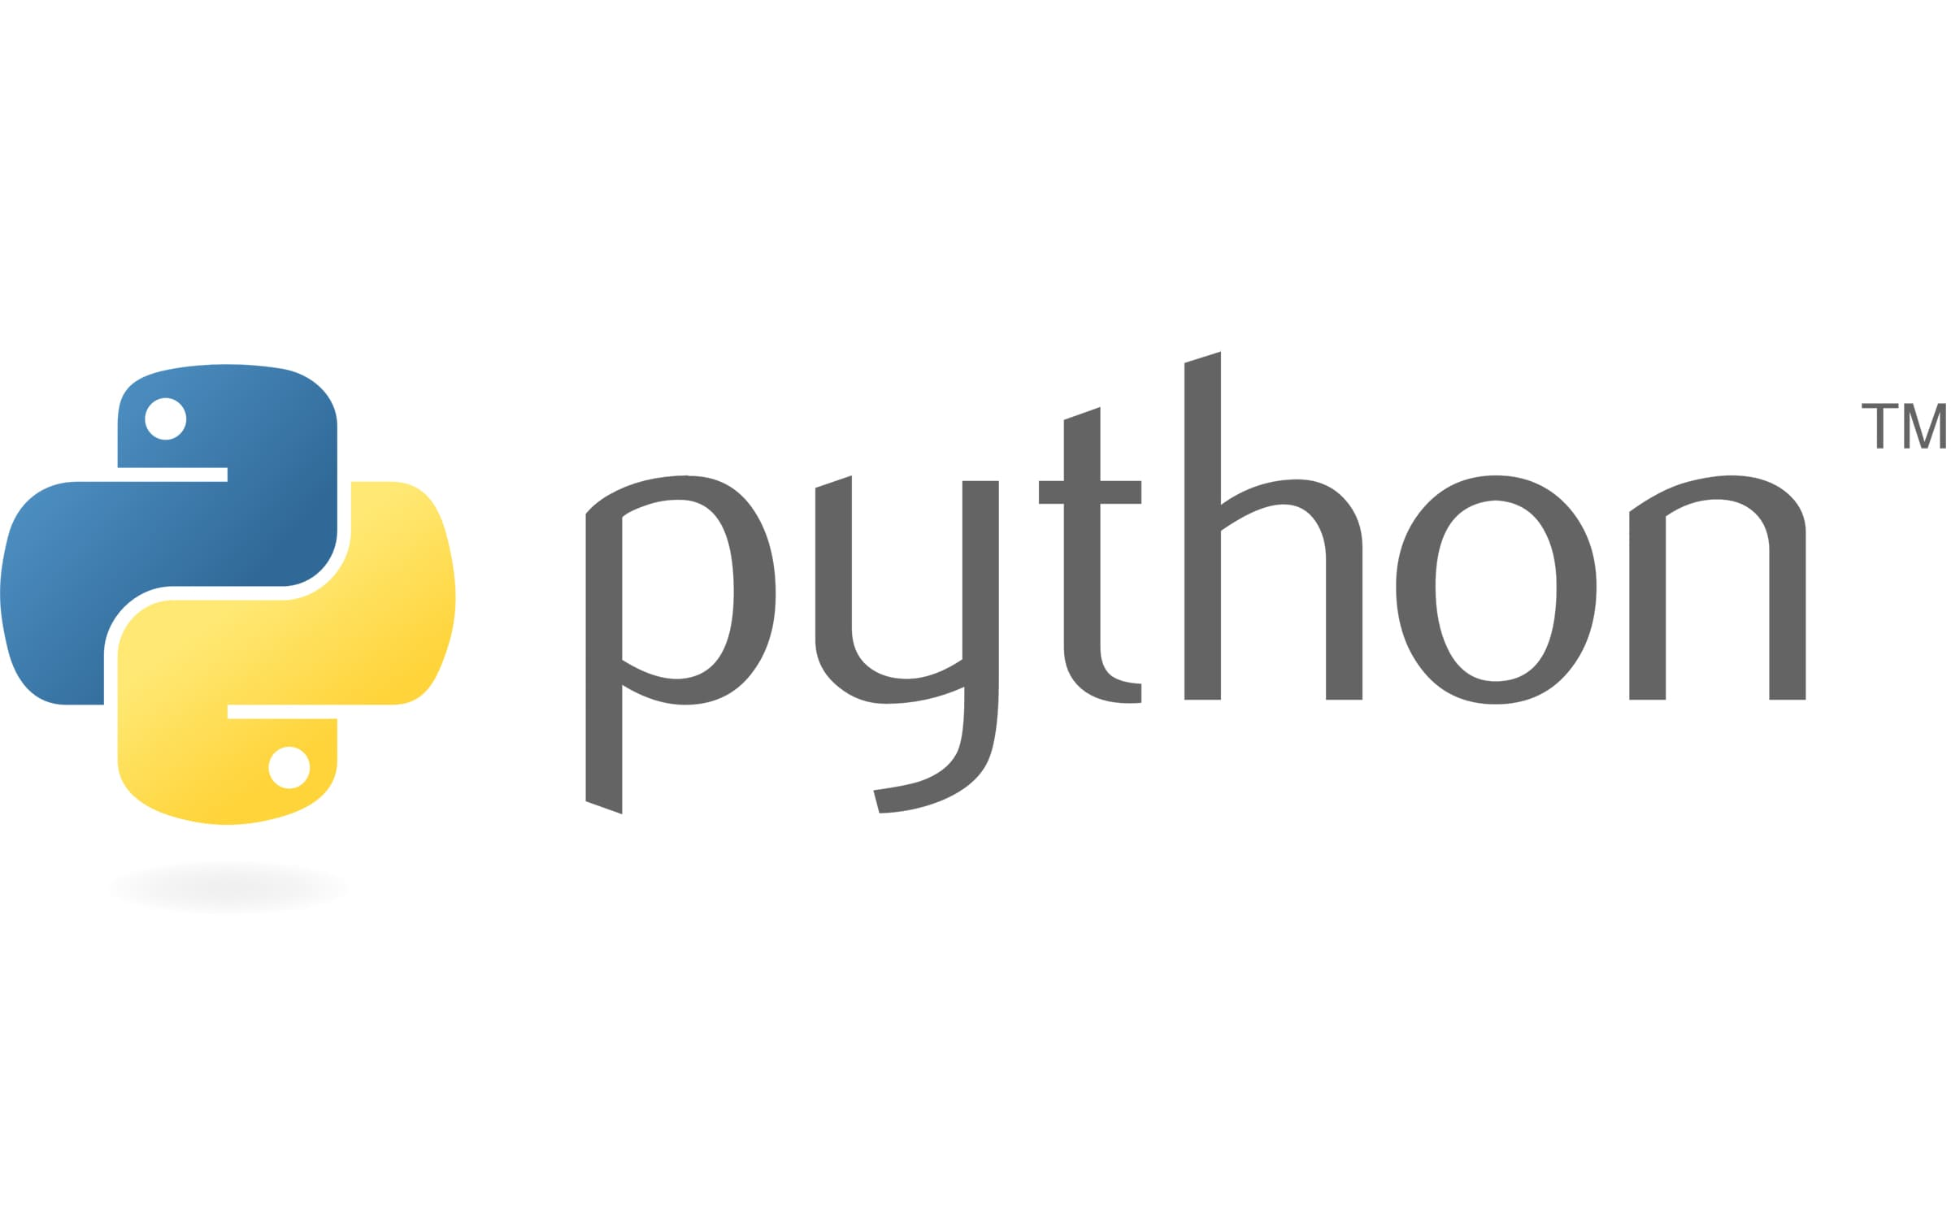
Why Python?
Simple to read: It's like speaking simple English to computers.
Versatile: Used for websites, apps, and especially... data!
Popular: Lots of resources and a huge community.

Slide 5

Python Fundamentals: Variables
Think of a variable as a labeled box where you store data.
You give the box a name, and you can change what's inside.
Example:
name = "Alice" (A box named name holding "Alice")
age = 25 (A box named age holding the number 25)
Alice
name

Slide 6
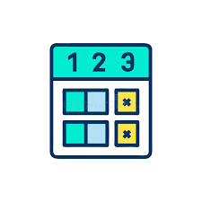

Python Fundamentals: Numbers and Text
Numbers: For calculations (like 10, 3.14, 100)
Text (Strings): For words and sentences (like "Hello", "Data Analysis")
Important: Text usually goes inside quotes! "" or ''

Slide 7
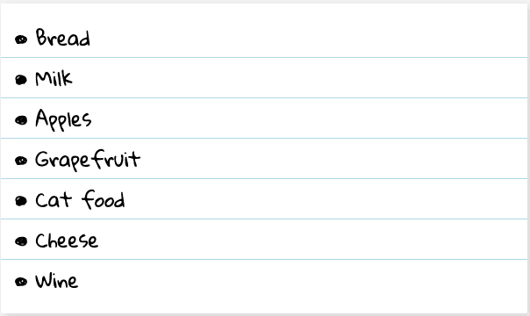
Python Fundamentals: Lists - Storing Multiple Items
A list is like a shopping list or a collection of items.
You can put numbers, text, or even other lists inside!
Example:
grades = [85, 92, 78, 88]
names = ["Alice", "Bob", "Carol"]

Slide 8
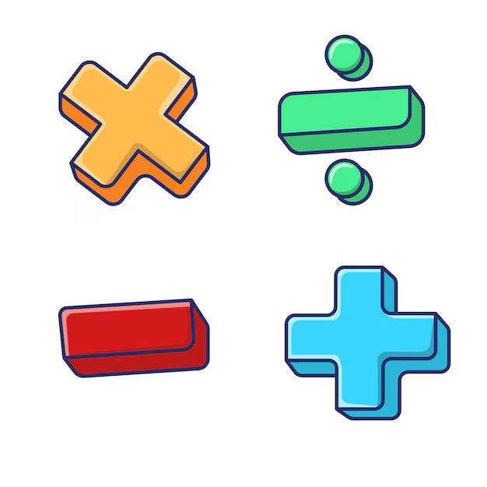
Python Fundamentals: Simple Operations
Math:
+ (add)
- (subtract)
* (multiply)
/ (divide)
Comparing:
> (greater than)
< (less than)
== (is equal to?)
These help us combine, change, or check our data.

Slide 9
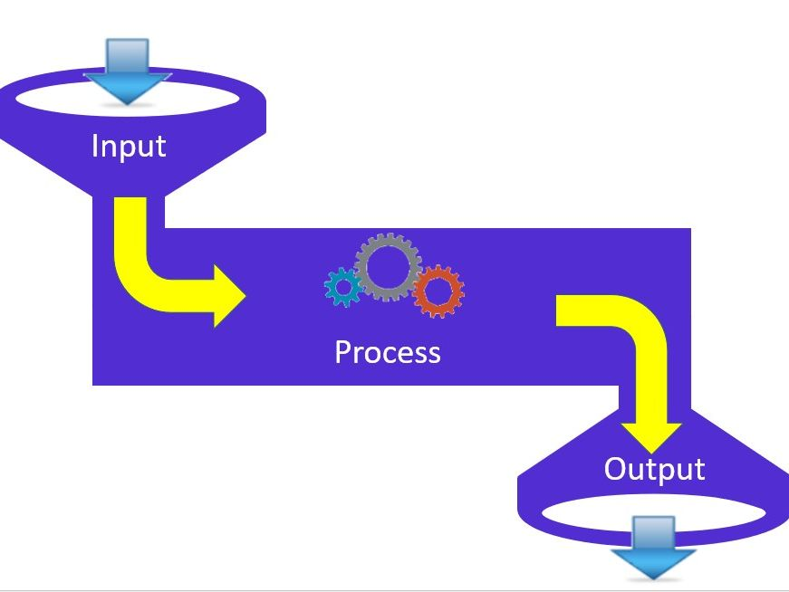
Python Fundamentals: Basic Functions
Functions are like pre-made tools that do specific jobs.
You give them something, and they give you a result.
print(): To show results on the screen.
len(): To count items in a list or characters in text.
max(), min(): To find the highest/lowest number in a list.

Slide 10

Writing Your First Code!
Creating variables with your own data.
Using print() to see results.
Working with lists of numbers.
Simple calculations.

Slide 11
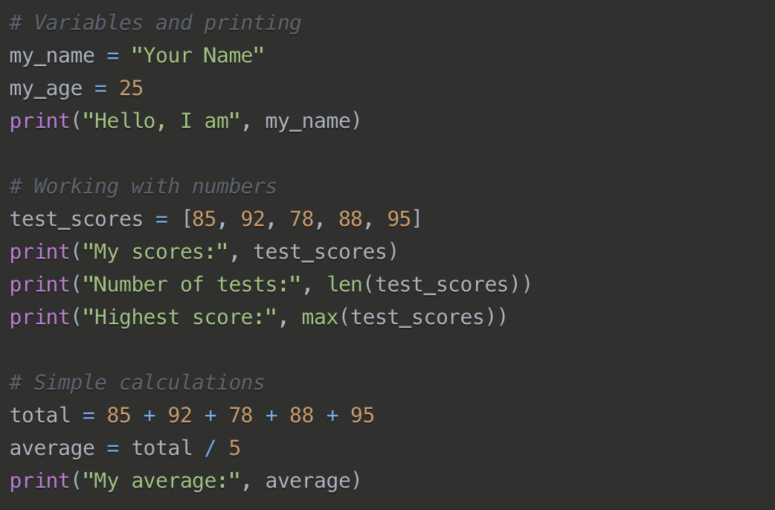
My First Python Program

Slide 12

Setting Up & First Steps: Installing & Using Jupyter
What is Jupyter?
A special notebook where we write and run Python code. It shows code and results together.
Installing Anaconda: This is the easiest way! It includes Python, Jupyter, and everything else we need. (We'll walk through this).
Opening Jupyter notebooks.
Creating your first notebook.

Slide 13
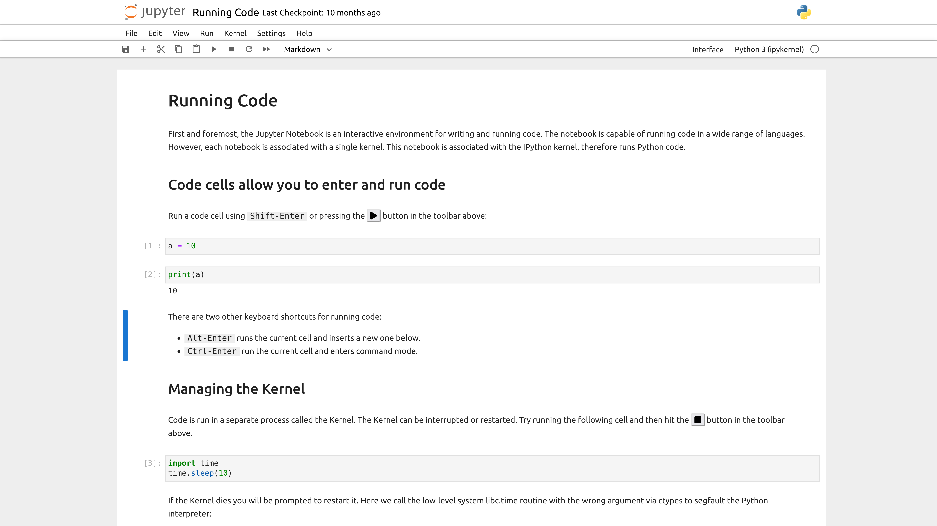

Slide 14
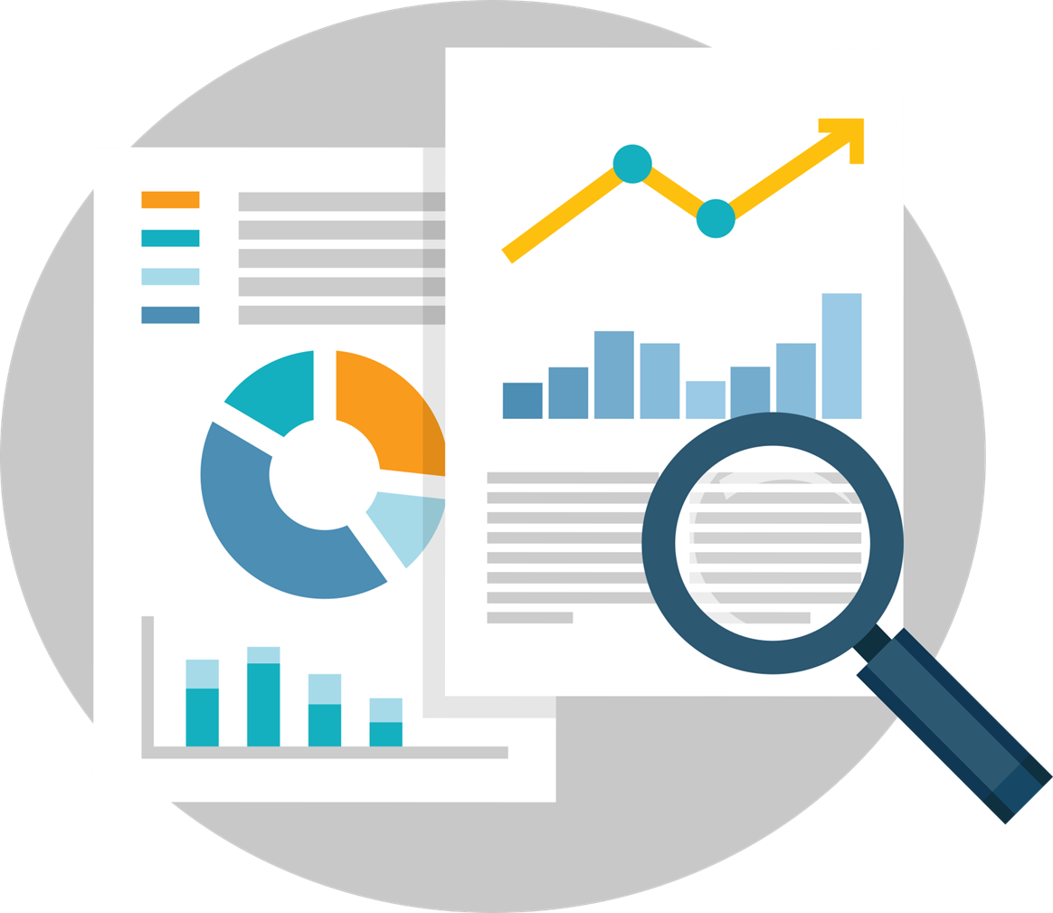
Introduction to Data Analysis
What is data?
Information we want to understand.
Examples: Student grades, weather temperatures, sales numbers from a store, survey responses.
Why Python?
It helps us work with lots of data very quickly and find hidden insights!

Slide 15
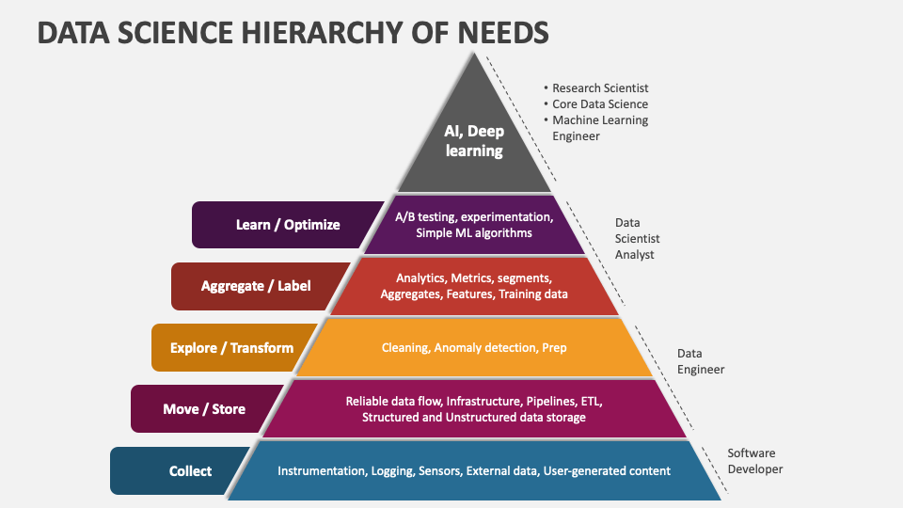

Slide 16


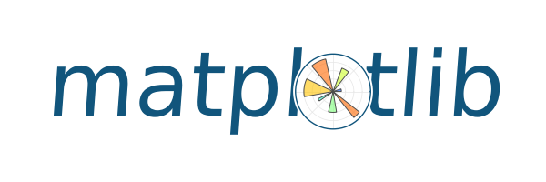
Python Libraries for Data Analysis
NumPy
Handles large arrays and matrices
Performs fast numerical operations
Basis for many other libraries
Pandas
Works with structured data using DataFrames
Easy reading/writing of CSV, Excel, JSON, etc.
Filtering, grouping, merging, and reshaping data
Matplotlib
Creates basic plots: line, bar, scatter, etc.
Highly customizable graphs
Good for static visualizations

Slide 17
What is NumPy?
NumPy (Numerical Python) is a powerful open-source library for numerical and scientific computing. It provides:
A high-performance multidimensional array object (ndarray)
Tools for working with these arrays
Functions for performing mathematical operations efficiently

Slide 18
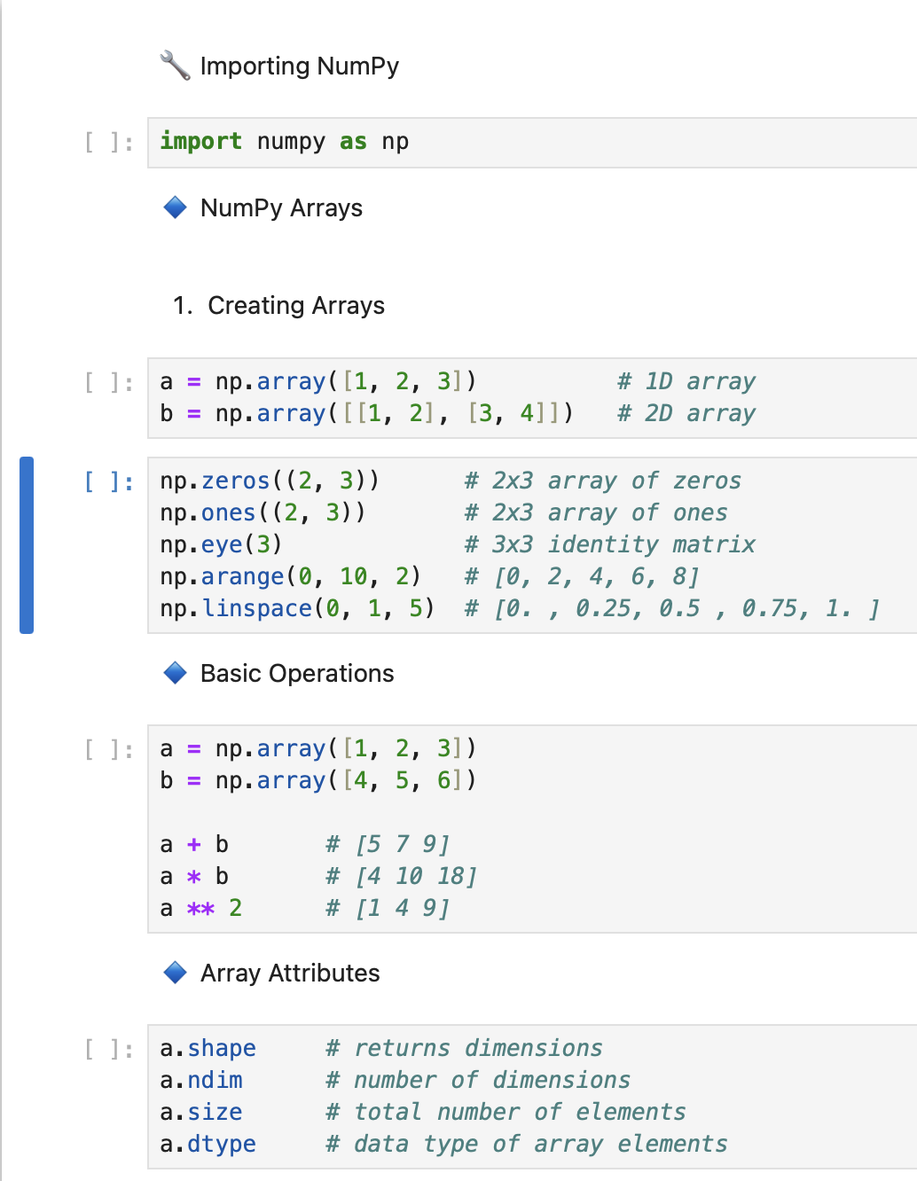
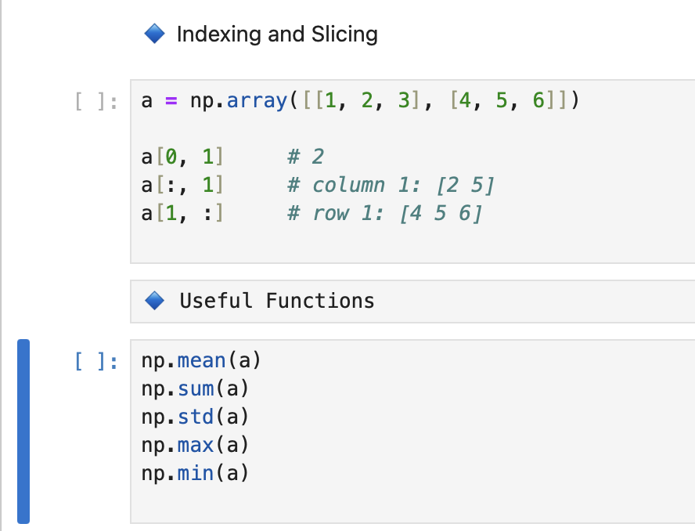

Slide 19
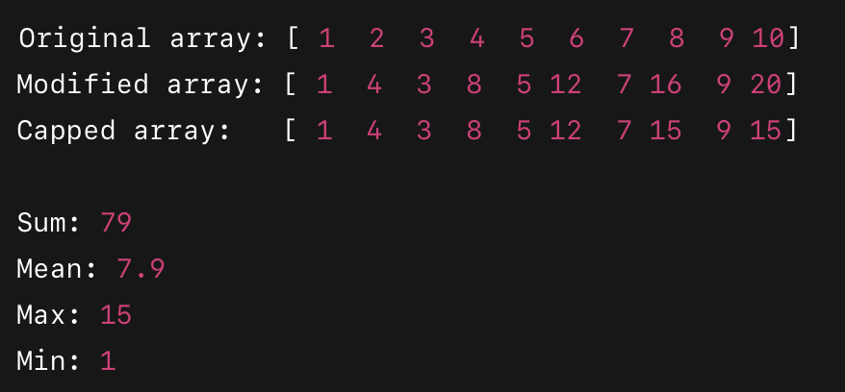
Task:
Create a 1D NumPy array named arr with values from 1 to 10.
Multiply all even numbers in arr by 2.
Replace all values greater than 15 in arr with 15.
Calculate and print the:
Sum of all elements
Mean of all elements
Maximum and minimum values

Slide 20
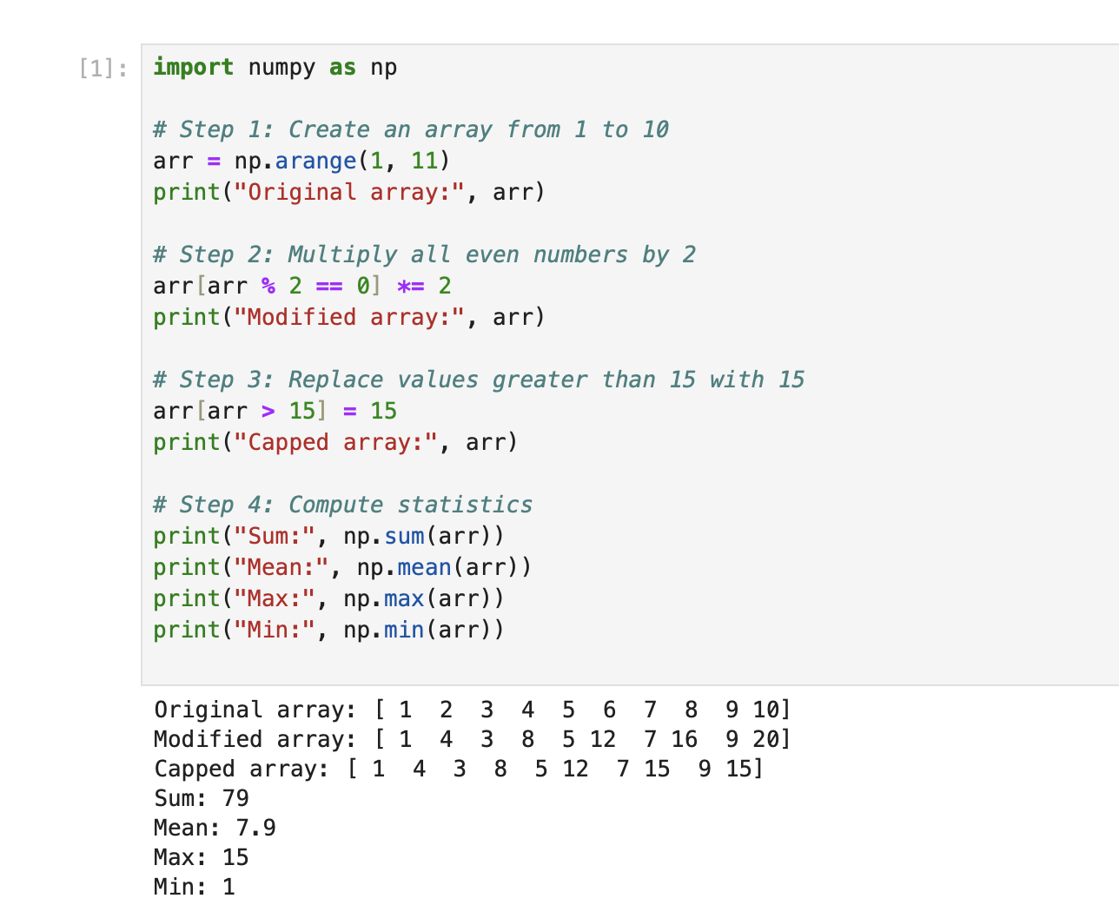
Solution:

Slide 21
Q & A

